Slide 1




Programming with JavaScript and jQuery
Day 1

Slide 2
Working with Functions
Methods
Procedures associated with an object
Functions
Related group of JavaScript statements
Executed as a single unit
Virtually identical to methods
Not associated with an object
Must be contained within a script element

Slide 3
Defining Functions
Named function
Related statements assigned a name
Call, or reference, named function to execute it
Anonymous function
Related statements with no name assigned
Work only where they are located in code
Use named function when you want to reuse code

Slide 4
Defining Functions
Function definition
Lines making up a function
Named function syntax
function name_of_function(parameters) {
statements;
}
Anonymous function syntax
function (parameters) {
statements;
}

Slide 5
Defining Functions
Parameter
Variable used within a function.
Placed within parentheses following a function name.
Multiple parameters are allowed.
function calculateVolume(length, width, height){
}

Slide 6
Defining Functions
Function statements
Do the actual work
Contained within function braces
Put functions in an external .js file
Reference at bottom of body section
function calculateVolume(length, width, height) {
var volume = length * width * height;
alert(volume);
}

Slide 7
Exercise: Fan Trick Photography
Go to the “WA120_data_files” folder.
Open the “Chapter02” sub-folder.
Open the folder labeled “Chapter”
COPY the data files contained within.
Navigate to the folder where you keep your projects.
Create a new folder named “fan_trick_photo”
PASTE the data files in this new folder.

Slide 8
Exercise: Fan Trick Photography
In Notepad ++, open the file from the “fan_trick_photo” folder named “estimate.htm”.
In the comment section at the top, add your name and change the current date.
Run the “estimate.htm” in a browser.
As of now, changes can be made to the form elements, but nothing in the “estimate” area changes because there has yet to be JavaScript which will enable this action to occur.

Slide 9
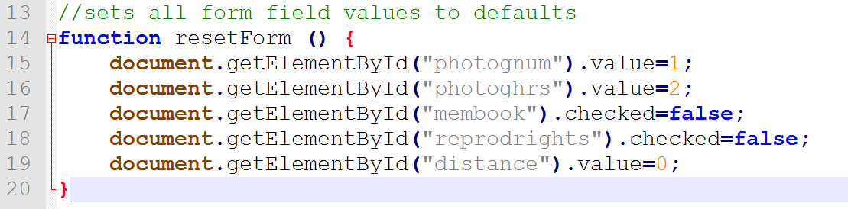
Exercise: Fan Trick Photography
In Notepad ++, open the file from the “fan_trick_photo” folder named “ft.js”
Change the name and date in the comment section.
Enter the following code under the comments:

Slide 10
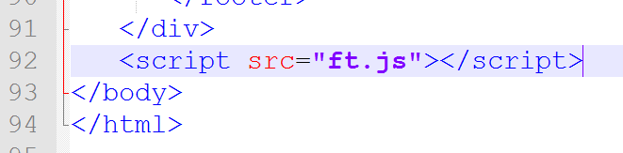
Exercise: Fan Trick Photography
Switch back to “estimate.htm”.
Near the bottom of the document, just before the closing </body> tag, enter the following <script> element:

Slide 11
Calling Functions
To execute a named function:
Must invoke, or “call” it
Functions do not execute automatically
Function call
Refers to the code calling a function
Consists of function name followed by parentheses
Contains any variables or values assigned to the function parameters
Arguments (a.k.a.: actual parameters)
Variables (values) placed in the function call statement parentheses

Slide 12
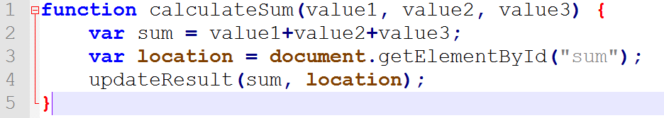
Calling Functions
Passing arguments
Sending arguments to parameters of a called function
Argument value assigned to the corresponding parameter value in the function definition
Line 4 passes the results of the
“calculateSum” function to another
function named “updateResult”.

Slide 13
Calling Functions
Handling Events
Functions can be called in response to browser events.
Three methods for doing this are supported by browsers:
Specify the function as value for HTML attribute:
<input type="submit" onclick="showMessage()" />
Specify the function as property value for object:
document.getElementById("submitButton").onclick =showMessage;
Use addEventListener() method:
var submit = document.getElementById("submitButton");
submit.addEventListener("click", showMessage, false);
Adding an event listener is most flexible
Separates HTML and JavaScript code
Can specify several event handlers for a single event

Slide 14
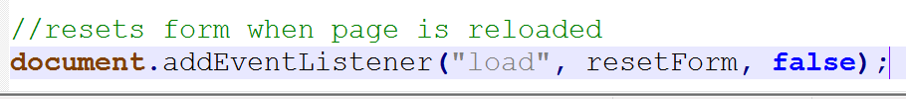
Exercise: Fan Trick Photography
Return to the “ft.js” file in Notepad ++
Add the following comment and statement on a new line below the function we added earlier:

Slide 15
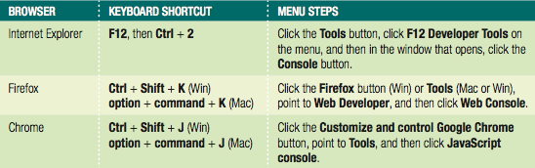
Locating Errors with the Browser Console
Unintentional coding mistakes keep code from working
Browsers generate error messages in response
Messages displayed in browser console pane
Hidden by default to avoid alarming users
Developers display browser console to see errors

Slide 16
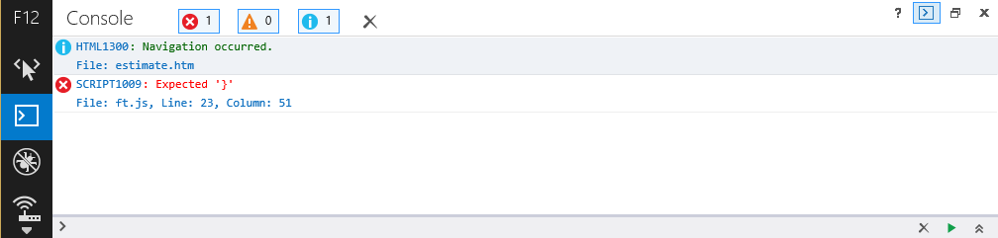
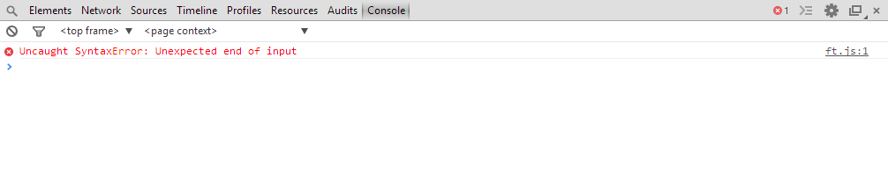
Locating Errors with the Browser Console
Consoles specify a line number with each error
Figure 2-3: Internet Explorer browser console
Figure 2-4: Chrome browser console

Slide 17
Exercise: Fan Trick Photography
Let’s introduce an intentional error in our code.
In the file “ft.js”, delete the closing curly brace at the end of the resetForm function.
Save the changes to “ft.js”, then return to the browser.
Open the developer console and then refresh the page. View the error.
Return to “ft.js” and replace the closing curly brace.
Refresh the browser and note that the error should now be clear.

Slide 18
Using Return Statements
Can return function value to a calling statement
Return statement
Returns a value to the statement calling the function
Use the return keyword with the variable or value to send to the calling statement
Example:
function averageNumbers(a, b, c) {
var sum_of_numbers = a + b + c;
var result = sum_of_numbers / 3;
^{return result;}
}

Slide 19
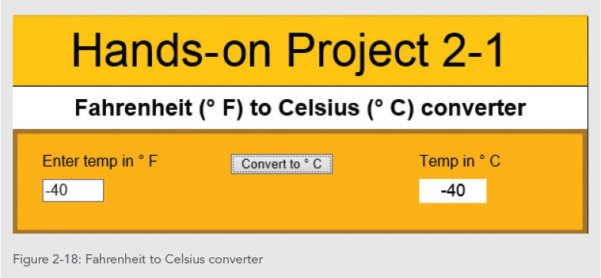
Exercise
Using the examples from previous slides, create a JavaScript function that converts Fahrenheit temperature (input from a text field) to Celcius (output to another text field).

Slide 20
Answer:
^{<!DOCTYPE html>}
^{<html>}
<title>Celsius to Fahrenheit Temperature Converter</title>
^{<body>}
^{<h2>Temperature Converter</h2>}
<p>Type a value in the Celsius field to convert the value to Fahrenheit:</p>
^{<p>}
^{<label>Celsius</label>}
<input id="inputCelsius" type="number" placeholder="Celsius" oninput="temperatureConverter(this.value)" onchange="temperatureConverter(this.value)">
^{</p>}
<p>Fahrenheit: <span id="outputFahrenheit"></span></p>
^{<script>}
function temperatureConverter(valNum) {
^{valNum = parseFloat(valNum);}
document.getElementById("outputFahrenheit").innerHTML=(valNum*1.8)+32;
}
^{</script>}
^{</body>}
^{</html>}

Slide 21
Understanding Variable Scope
Variable scope
Where in code a declared variable can be used
Global variable
Declared outside a function
Available to all parts of code
Local variable
Declared inside a function
Only available within the function in which it is declared
Ceases to exist when the function ends
Keyword var required

Slide 22
Understanding Variable Scope
Good programming technique
Always use the var keyword when declaring variables
Clarifies where and when variable used
Poor programming technique
Declaring a global variable inside of a function by not using the var keyword
Harder to identify global variables in your scripts when you do not use the var keyword.

Slide 23
Understanding Variable Scope
If variable declared within a function and does not include the var keyword
Variable automatically becomes a global variable
Program may contain global and local variables with the same name
Local variable takes precedence
Value assigned to local variable of the same name
Not assigned to global variable of the same name

Slide 24
Understanding Variable Scope
^{var color = "green";}
function duplicateVariableNames() {
^{var color = "purple";}
^{document.write(color);}
^{// value printed is purple}
}
^{duplicateVariableNames();}
^{document.write(color);}
^{// value printed is green}
Why is the first printed value “purple”?
Why is the second printed value “green”?
How would you change the program to print “purple” both times?
NOTE: It is usually poor practice to use the same name for local and global variables!

Slide 25
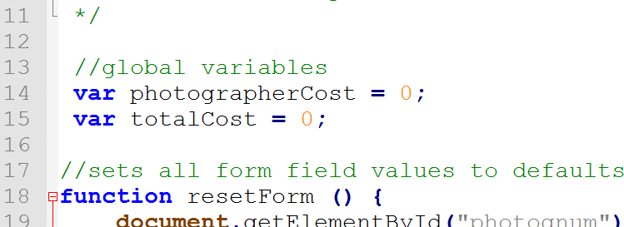
Exercise: Fan Trick Photography
Return to the “ft.js” file in Notepad ++
Below the comment area and above the resetForm() function, add the following statements to define 2 global variables:

Slide 26
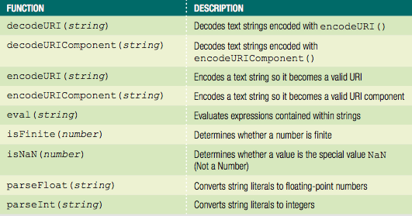
Using Built-in JavaScript Functions
Called the same way a custom function is called
Table 2-2 Built-in JavaScript functions

Slide 27
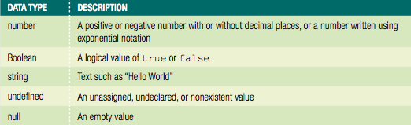
Working with Data Types
Data type
Specific information category a variable contains
Primitive types
Data types assigned a single value
Table 2-3 Primitive JavaScript data types

Slide 28
Working with Data Types
The null value: data type and a value
Can be assigned to a variable
Indicates no usable value
Use: ensure a variable does not contain any data
Undefined variable
Never had a value assigned to it, has not been declared, or does not exist
Indicates variable never assigned a value: not even null
Use: determine if a value being used by another part of a script

Slide 29

Working with Data Types
^{var stateTax;}
^{document.write(stateTax);}
^{stateTax = 40;}
^{document.write(stateTax);}
^{stateTax = null;}
^{document.write(stateTax);}

Slide 30
Working with Data Types
Strongly typed programming languages
Require declaration of the data types of variables
Strong typing also known as static typing
Data types do not change after declared
Loosely typed programming languages
Do not require declaration of the data types of variables
Loose typing also known as dynamic typing
Data types can change after declared

Slide 31
Working with Data Types
JavaScript interpreter automatically determines data type stored in a variable
Examples:
diffTypes = "Hello World"; // String
diffTypes = 8; // Integer number
diffTypes = 5.367; // Floating-point number
diffTypes = true; // Boolean
diffTypes = null; // Null

Slide 32
Understanding Numeric Data Types
JavaScript supports two numeric data types
Integers and floating-point numbers
Integer
Positive or negative number with no decimal places
Floating-point number
Number containing decimal places or written in exponential notation
Exponential notation (scientific notation)
Shortened format for writing very large numbers or numbers with many decimal places

Slide 33
Exercise: Fan Trick Photography
In Notepad++, open the “digital.htm” document from the “fan_trick_photography” folder.
Enter your name and the current date in the comment section, save the file and then run the file in your browser.

Slide 34
Exercise: Fan Trick Photography
In “digital.htm”, add a <script> element above the opening <table> tag. Enter the code which contain variable declarations for the 20 metric prefixes (see pages 94 & 95 step 3).

Slide 35
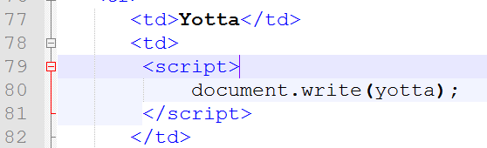
Exercise: Fan Trick Photography
Within the <table> element, in the second row, within the empty <td> element, enter the following script section which will print the value of the variable that corresponds to the prefix:

Slide 36
Exercise: Fan Trick Photography
Continue to add script sections within the empty <td> elements of the table to add the relevant variable names for each row.
NOTE: be sure to spell the variable names correctly and match the lowercase that we used to declare the variables with in Step 3.

Slide 37
Using Boolean Values
Logical value of true or false
Used for decision making
Which parts of a program should execute
Used for comparing data
JavaScript programming Boolean values
The words true and false
JavaScript converts true and false values to the integers 1 and 0 when necessary

Slide 38

Using Boolean Values
^{var newCustomer = true;}
^{var contractorRates = false;}
document.write("<p>New customer: " + newCustomer + "</p>");
document.write("<p>Contractor rates: " + contractorRates + "</p>");

Slide 39
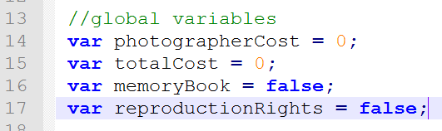
Exercise: Fan Trick Photography
In Notepad++, return to the “ft.js” file.
Below the totalCost variable, add the following global variables:

Slide 40
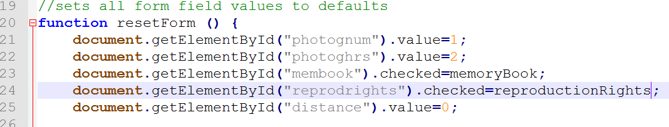
Exercise: Fan Trick Photography
Within the resetForm() function, change the values “checked” to the appropriate variable values:

Slide 41
Working with Strings
Text string
Contains zero or more characters
Surrounded by double or single quotation marks
Can be used as literal values or assigned to a variable
Empty string
Zero-length string value
Valid for literal strings
Not considered to be null or undefined

Slide 42
Working with Strings
To include a quoted string within a literal string surrounded by double quotation marks
Surround the quoted string with single quotation marks
To include a quoted string within a literal string surrounded by single quotation marks
Surround the quoted string with double quotation marks
String must begin and end with the same type of quotation marks

Slide 43
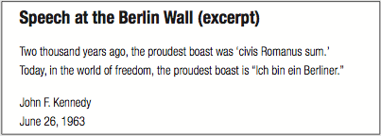
Working with Strings
document.write("<h1>Speech at the Berlin Wall (excerpt)</h1>");
document.write("<p>Two thousand years ago, the proudest boast was 'civis Romanus sum.'<br />");
document.write('Today, in the world of freedom, the proudest boast is "Ich bin ein Berliner."</p>');
var speaker = "<p>John F. Kennedy</br>";
var date = 'June 26, 1963</p>';
^{document.write(speaker);}
^{document.write(date);}

Slide 44
Working with Strings
String operators
Concatenation operator (+): combines two strings
^{var destination = "Honolulu";}
^{var location = "Hawaii";}
destination = destination + " is in " + location;
Compound assignment operator (+=): combines two strings
^{var destination = "Honolulu";}
destination += " is in Hawaii";
Plus sign
Concatenation operator and addition operator

Slide 45
Working with Strings
Escape characters and sequences
Escape character
Tells the compiler or interpreter that the character that follows has a special purpose
In JavaScript, escape character is backslash (\)
Escape sequence
Escape character combined with other characters
Most escape sequences carry out special functions

Slide 46
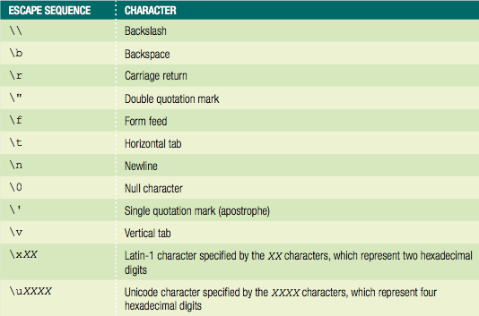
Working with Strings
Table 2-4 JavaScript escape sequences

Slide 47
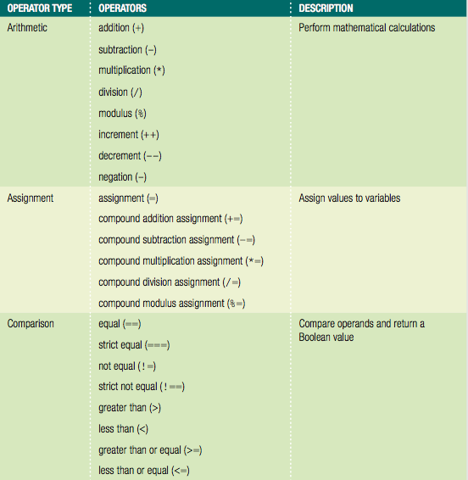
Using Operators to Build Expressions
Table 2-5 JavaScript operator types

Slide 48
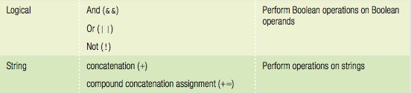
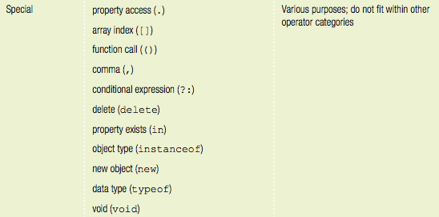
Using Operators to Build Expressions
Table 2-5 JavaScript operator types (cont'd.)

Slide 49
Using Operators to Build Expressions
Binary operator
Requires an operand before and after the operator
Unary operator
Requires a single operand either before or after the operator
binary
myNumber = 100;
myNumber++;
unary

Slide 50
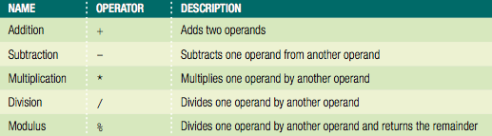
Arithmetic Operators
Perform mathematical calculations
Addition, subtraction, multiplication, division
Returns the modulus of a calculation
Arithmetic binary operators
Table 2-6 Arithmetic binary operators

Slide 51
Arithmetic Operators
Arithmetic binary operators (cont’d.)
Value of operation on right side of the assignment operator assigned to variable on the left side
Example: arithmeticValue = x + y;
Result assigned to the arithmeticValue variable
Division operator (/)
Standard mathematical division operation
Modulus operator (%)
Returns the remainder resulting from the division of two integers

Slide 52

Arithmetic Operators
^{var divisionResult = 15 / 6;}
^{var modulusResult = 15 % 6;}
document.write("<p>15 divided by 6 is “ + divisionResult + ".</p>"); // prints '2.5'
document.write("<p>The whole number 6 goes into 15 twice,
with a remainder of "+ modulusResult + ".</p>"); // prints '3'
Figure 2-13 Division and modulus expressions

Slide 53
Arithmetic Operators
Arithmetic binary operators
Assignment statement
Can include combination of variables and literal values on the right side
Cannot include a literal value as the left operand
JavaScript interpreter
Attempts to convert the string values to numbers
Does not convert strings to numbers when using the addition operator

Slide 54

Arithmetic Operators
Prefix operator
Placed before a variable
Postfix operator
Placed after a variable
Table 2-7 Arithmetic unary operators

Slide 55
Arithmetic Operators
Arithmetic unary operators
Performed on a single variable using unary operators
Increment (++) unary operator: used as prefix operators
Prefix operator placed before a variable
Decrement (--) unary operator: used as postfix operator
Postfix operator placed after a variable
Example: ++count; and count++;
Both increase the count variable by one, but return different values

Slide 56
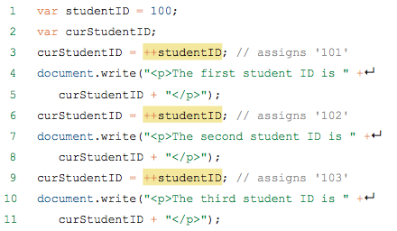

Arithmetic Operators
Figure 2-14 Output of the prefix version of the student ID script

Slide 57

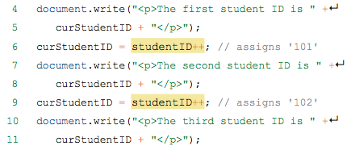

Arithmetic Operators
Figure 2-15 Output of the postfix version of the student ID script

Slide 58
Assignment Operators
Used for assigning a value to a variable
Equal sign (=)
Assigns initial value to a new variable
Assigns new value to an existing variable
Compound assignment operators
Perform mathematical calculations on variables and literal values in an expression
Then assign a new value to the left operand

Slide 59
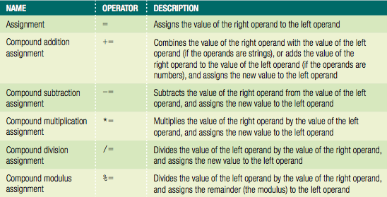
Assignment Operators
Table 2-8 Assignment operators

Slide 60
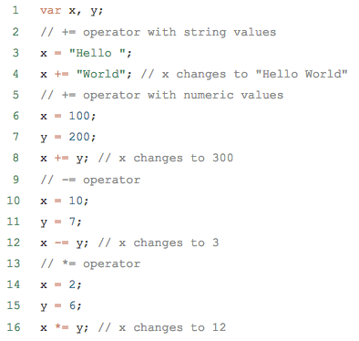
Assignment Operators
+= compound addition assignment operator
Used to combine two strings and to add numbers
Examples:

Slide 61
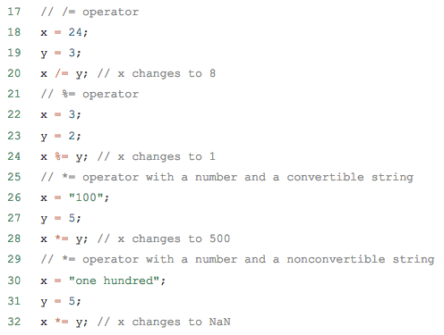
Assignment Operators
Examples:

Slide 62
Exercise: Fan Trick Photography

Slide 63
Comparison and Conditional Operators
Comparison operators
Compare two operands
Determine if one numeric value is greater than another
Boolean value of true or false returned after compare
Operands of comparison operators
Two numeric values: compared numerically
Two nonnumeric values: compared in alphabetical order
Number and a string: convert string value to a number
If conversion fails: value of false returned

Slide 64
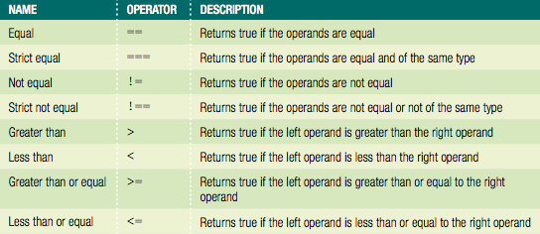
Comparison and Conditional Operators
Table 2-9 Comparison operators

Slide 65
Comparison and Conditional Operators
Conditional operator
Executes one of two expressions based on conditional expression results
Syntax
conditional expression ? expression1 : expression2;
If conditional expression evaluates to true:
Then expression1 executes
If the conditional expression evaluates to false:
Then expression2 executes

Slide 66
Comparison and Conditional Operators
Example of conditional operator:
^{var intVariable = 150;}
^{var result;}
^{intVariable > 100 ?↵}
result = "intVariable is greater than 100" :↵
result = "intVariable is less than or equal to 100";
^{document.write(result);}

Slide 67
Falsy and Truthy Values
Six false values treated like Boolean false:
""
-0
0
NaN
null
undefined
All other values are truth, treated like Boolean true

Slide 68
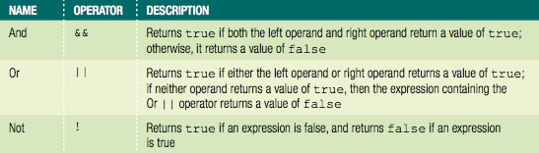
Logical Operators
Compare two Boolean operands for equality
Table 2-10 Logical operators

Slide 69
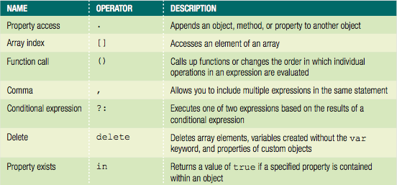
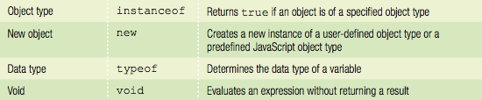
Special Operators
Table 2-11 Special operators

Slide 70
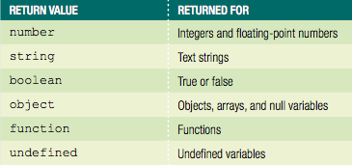
Special Operators
Table 2-12 Values returned by typeof operator

Slide 71
Understanding Operator Precedence
Operator precedence
Order in which operations in an expression evaluate
Associativity
Order in which operators of equal precedence execute
Left to right associativity
Right to left associativity

Slide 72
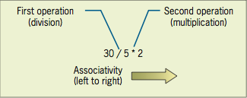
Understanding Operator Precedence
Evaluating associativity
Example: multiplication and division operators
Associativity of left to right
Figure 2-16 Conceptual illustration of left to right associativity

Slide 73
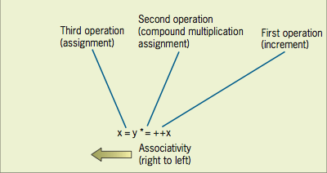
Understanding Operator Precedence
Evaluating associativity
Example: Assignment operator and compound assignment operators
Associativity of right to left
x = y *= ++x
^{var x = 3;}
^{var y = 2;}
^{x = y *= ++x;}
Figure 2-17 Conceptual illustration of right-to-left associativity

Slide 74
Summary
Functions
Similar to methods associated with an object
Pass parameters
To execute, must be called
Variable scope
Where a declared variable can be used
Global and local variables
Data type
Specific category of information a variable contains
Static typing and dynamic typing
Numeric data types: integer and floating point
Boolean values: true and false
Strings: one or more character surrounded by double or single quotes
String operators
Escape character
Operators build expressions
Operator precedence
Order in which operations in an expression are evaluated

Slide 75
Exercise
Create a script that calculates the total of shopping cart + sales tax.
Use conditional statements to determine which selections the user made. Example:
var item1 = document.getElementById(“item1”);
var itemTotal += (item1.checked) ? 8 : 0;
Make sure the result has a dollar sign in the front.
Test in all browsers that you have installed.

Slide 76
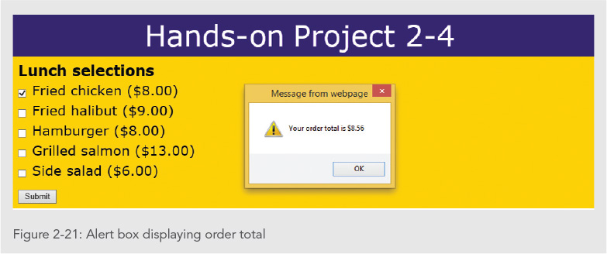
Exercise

